Slide 1



Mental Health 101

Slide 2


Contents
Key Terms in Mental Health
What is Mental Health?
How Common are Mental Health Conditions?
Risk Factors
Where to Seek Help & Available Resources

Slide 3

Key Terms in Mental Health
Lived experience: first-hand, personal experience dealing with a mental health or substance use challenge
Mental health concern: anything that causes a person to believe their mental health may be suffering; could be a symptom, a group of symptoms, or a diagnosable mental health condition
Mental health condition: a set of related symptoms that have been recognized by the mental health community; includes conditions defined in the DSM-V, ICD-11, and by people with lived experience
Risk factor: something that increases the chances of developing a condition
Stigma: negative, judgmental, and/or discriminatory attitudes toward mental health conditions and those who live with them

Slide 4
Key Terms in Mental Health Continued…
Protective factor: something that decreases the chances of developing a condition and/or balances out an existing risk factor
Coping skill: a strategy to help you deal with difficult situations and lessen unpleasant emotions, thoughts, or behaviors
Peer: someone who shares the experience of living with a mental health condition and/or substance use disorder
Recovery: a process of change through which individuals improve their health and wellness, live self-directed lives, and strive to reach their full potential
Social determinants of health: the conditions in which people live, learn, work, and play that impact their health and quality of life

Slide 5

What is Mental Health?
Mental health is something we ALL have. Your mental health combines your thoughts, feelings, and well-being.
It changes daily based on many factors and isn’t simply categorized as good or bad. Your mental health can be in a good place, even if you have a mental health condition, if you are properly taking care of yourself and seeking help and support.

Slide 6

What is a Mental Health Condition?
A mental health condition is different than simply our mental health but is often used interchangeably.
Everyone has mental health - while mental health conditions are common, not everyone has one.
A mental health condition is a set of related symptoms that have been recognized by the mental health community; includes conditions defined in the DSM-V, ICD-11, and by people with lived experience

Slide 7
Mental Health vs. Mental Health Conditions
  Something we all have
  Can change based on internal and external factors
  Can be better or worse depending on life’s circumstances and how we take care of ourselves
  Something that many people experience at some point in their life
  Includes a set of related diagnosable symptoms
  Can be treated in various ways

Slide 8
How Common are Mental Health Conditions?
  Nearly 1 in 5 Americans live with a mental health condition in any given year.
  Almost half of Americans will have a mental health condition at some point in their lives. Half of those will experience a mental health condition by age 14.
  Mental health conditions are more common among women, people of color, and members of the LGBTQ+ community.
  Most people who experience mental health conditions do not receive treatment.
  Many people don’t even know they have a mental health condition. It can take years from the time a mental health condition appears to the time it gets diagnosed—if it gets diagnosed at all.
‹#›

Slide 9
What Plays a Role in Developing a Mental Health Condition?
Most mental health conditions don’t have a single cause – they have many possible causes, called risk factors.
The more risk factors you have, the more likely you are to develop a mental health condition in your lifetime.
Risk factors don’t just affect who will and who won’t develop a mental health condition. They also impact the seriousness of symptoms and when those symptoms will show up.
‹#›

Slide 10
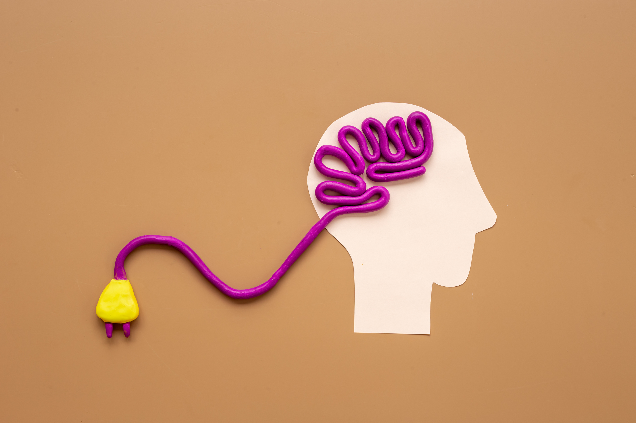
Common Risk Factors
Genetics - There’s no one gene that decides if you’ll have a mental health condition. Instead, many genes affect the way your brain develops, making you more or less likely to develop a mental health condition later.
Biology and Brain Chemistry - Some brains are wired differently, have too high or too low levels of certain neurotransmitters (chemicals that carry messages throughout your brain), or are damaged after a head injury. These differences can also affect your chances of developing a mental health condition.
‹#›

Slide 11
Where to Seek Help
If you are in crisis, please seek help immediately.
If you or someone you know is struggling or in crisis, help is available. Call or text 988 or chat 988lifeline.org.
If you are in need of support, but not in crisis, consider reaching out to a warmline. Warmlines offer a place to call when you just need to talk to someone. Speaking to someone on these calls is typically free, confidential, and run by people who understand what it’s like to struggle with mental health concerns. Find a warmline at mhanational.org/warmlines.
(ADD YOUR LOCAL RESOURCES HERE)
‹#›

Slide 12

Resources
  MHA’s Where to Start book store.mhanational.org
  MHA’s website
mhanational.org
  MHA’s screening website mhascreening.org
  (ADD YOUR LOCAL RESOURCES HERE)
‹#›

